Slide 1
Assignment 2 Presentation EECE 443 Team 2: MCU TNC Design Kaleb Leon – C00094357 Kobe Keopraseuth – C00092349 David Cain – C00043561 March 20th, 2020

Slide 2
MCU TNC Assignment 2
David Cain, Kobe Keopraseuth, and Kaleb Leon

Slide 3
Preliminary Design
Simulations
BJT PNP Circuit - http://tinyurl.com/uvuus54
Voltage Divider - http://tinyurl.com/tjcqvlk
Calculations
Drawings
Bill of Materials
Instructions of Assembly
Failure Mode Effects Analysis
Level 0/Level 1 Diagram

Slide 4
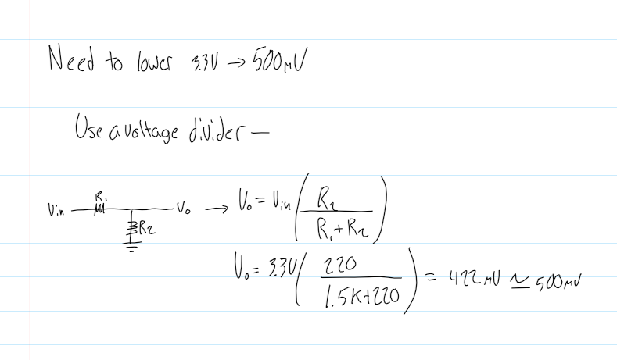
Calculations
Voltage Divider Calculations

Slide 5
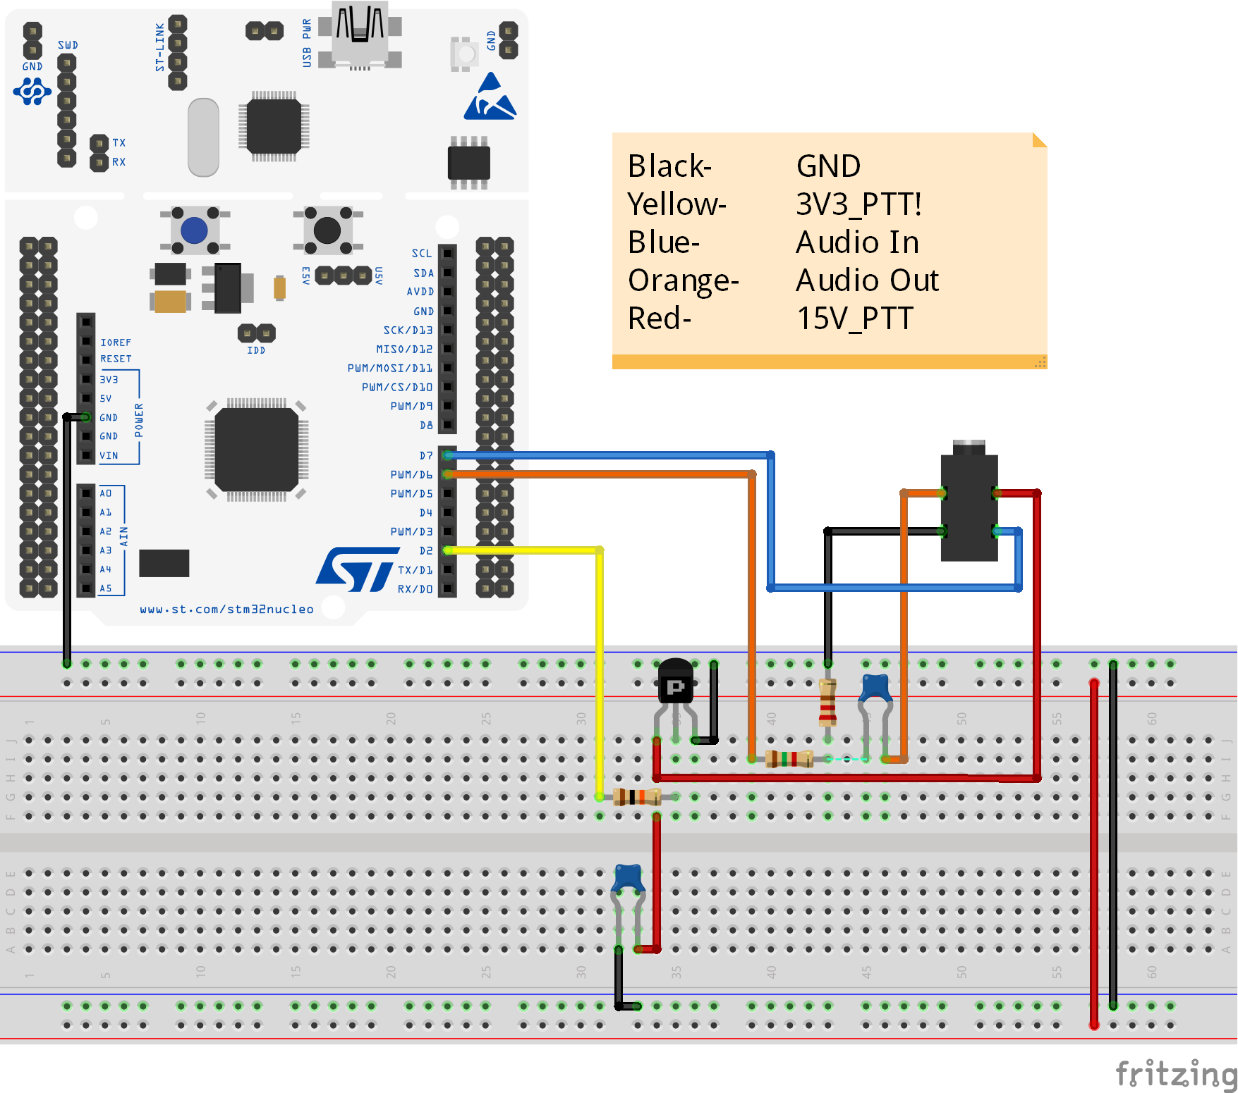
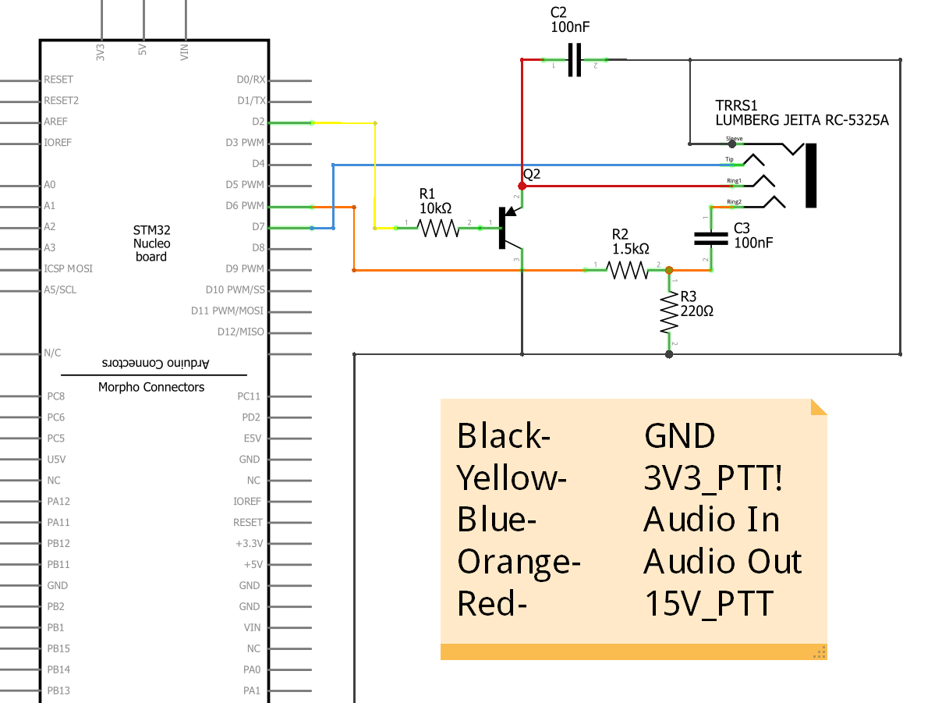
Drawings
Breadboard Layout
Schematic Layout

Slide 6
Bill of Materials
Bill of Materials Sent to Mentors

Slide 7
Failure Mode Effects Analysis
Process Step/Input | Potential Failure Mode | Potential Failure Effects | Potential Failure Causes | Action Recommended
Bits in packets | 1.) Receiving TNC/Computer mistakes bits for flags | 1.) misinterpretation of information from receiving end disposal of packet due to invalid size | 1.) Bits, anywhere in payload of KISS packet, are arranged as “11000000” Bits, anywhere not in flags of HDLC packet, are arranged as “01111110” | 1.) Bit stuffing: In KISS mode, a “1” is added after every “00000” arrangement in payload. Receiving TNC removes added “1” after every “00000” In a HDLC, a “0” is added after every “11111” arrangement. Receiving TNC removes added “0” after every “11111”
Packet format | 1.) Invalid Packet Format: Less than 136 bits in frame Not bounded by opening and closing flags Not octect aligned | ­1.) Inaccurate information received | 1.) Code failure Excess noise on the received audio to digital conversion | 1.) Receiving TNC disposes packet Rewrite Code
Transmitter | 1.) Transmitter is kept on for an extensive amount of time | 1.) Receiver is polling for an extensive amount of time for frames to be sent | 1.) Delay in frames being sent | 1.) Inter-Frame Time Fill: when necessary for a TNC to keep transmitter on while not sending frames, flags should be sent to fill in time between frames being sent
Microcontroller | 1.) Transmits audio signals with improper frequencies 2.) receives audio signal with noise | 1.) bit errors Receiving TNC misinterprets data 2.) bit errors in packets sent | ­1.) Incorrect code/configuration 2.) noisy environment | 1.) Reconfigure microcontroller or rewrite code 2.) check for good connections Move to a less noisy environment
Push-to-talk (PTT) | 1.) LED burns out 2.) MOSFET gets too hot | 1.) User cannot tell if TNC is sending audio signal to radio. 2.) Can damage components near MOSFET MOSFET can burn out and TNC cannot perform audio transmission | 1.) LED used is old 2.) MOSFET is consuming too much power insufficient MOSFET used to handle required Power improper capacitors and resistors used in PTT circuit | 1.) Replace old LED 2.) Add heat sink to MOSFET Replace MOSFET with a better one Reconsider using different resistors/capacitors in circuit
Failure Mode Effects Analysis
Failure Mode Effects Analysis

Slide 8
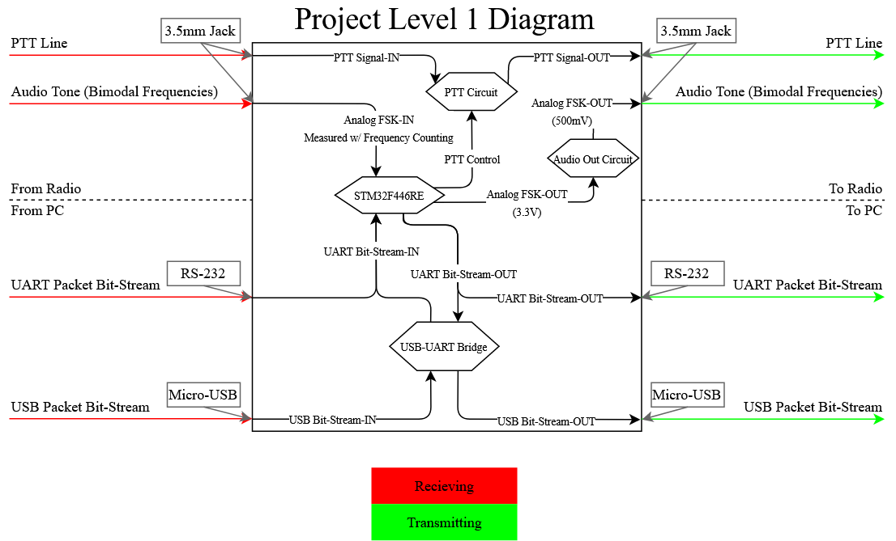
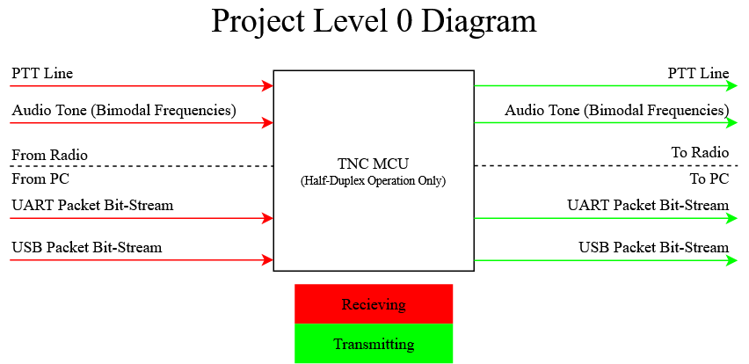
Level 0/Level 1 Diagrams
Level 0 Diagram
Level 1 Diagram

